Slide 1
Visit FengTian temple, spiritual heart of HsinKang and know more about Goddess Mazu

Slide 2
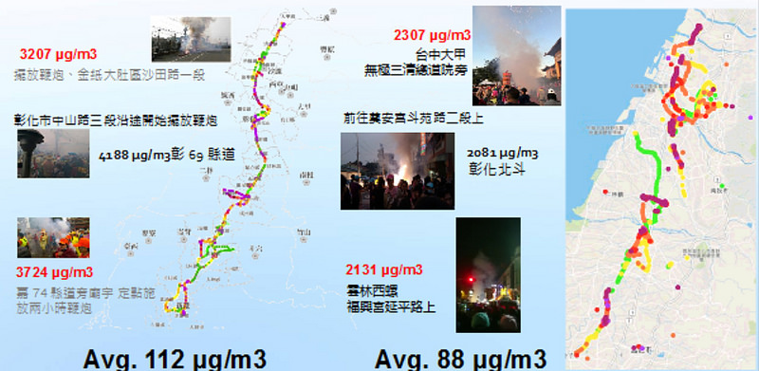
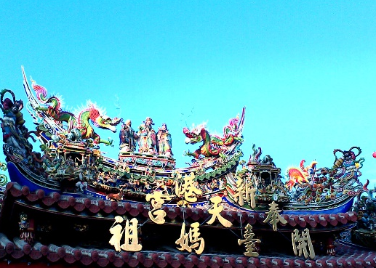
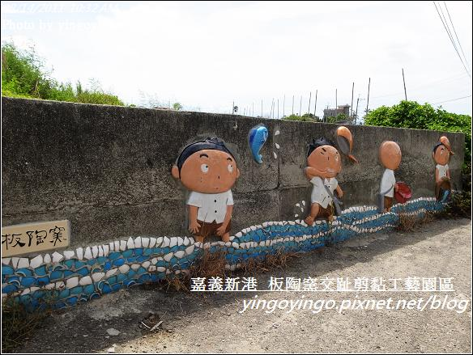
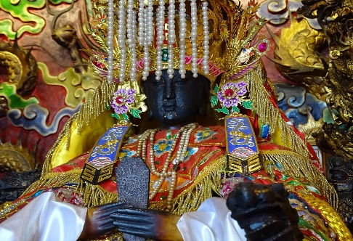
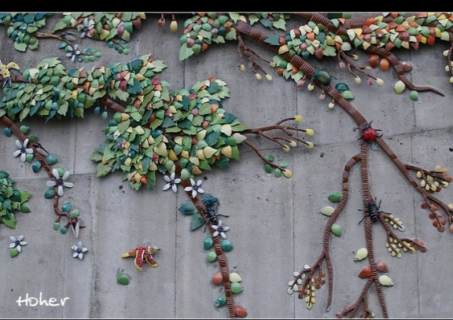
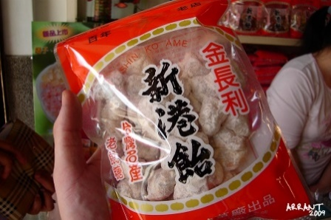
What we need to know around Fengtian Temple
Fengtian Temple
Stories of the Gods
Food
Tourist attractions
Values & reflections
History, Rituals, Festivals
Architecture

Slide 3
History
1622
1700
1811
1988
2007
Mazu came to Bengang and Fengtian temple was built | Tianhou (Heavenly Empress) Temple. | Naval Commander Wang De-lu (1770 – 1842) | Dajia Mazu Pilgrimage | Mazu’s New York trip, “UN for TW”
- Mazu comes from Meizhou to Bengang: to give blessings to the first immigrants of Taiwan. - Built at Bengang (笨港) in Min Dynasty | - Built to enshrine the Heavenly Mother, Mazu. It was later renamed Tianhou (Heavenly Empress) Temple. | - A big flood, made the temple reconstructed and moved to present location. | - Dajia Mazu Pilgrimage began to include HsinKang into the route. | - Mazu went to NY with previous President 陳水扁 to speak for Taiwan. - A wooden motto which says “UN for Taiwan.”

Slide 4
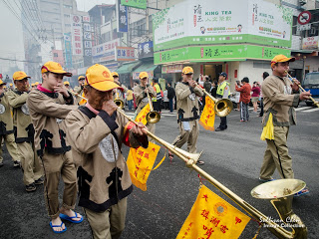
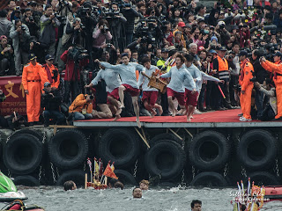
Historical Background
type
Taoist Temple: the most prosperous and attractive among three types of temples ( Buddhist Temples & Confucius Temples)
How
Someone contributing a lot to the society or nation with brave behaviors or morality will become a deity and keep the merit they made going.
Why
Mazu guided the fishing vessels after her families died in the sea. Fishermen and sailors built temples for her to keep safety when sailing.

Slide 5
Important Rituals – Floor plans

Slide 6
Important Rituals – Temple Parade (Zen Tou)
Holy Generals
Holy Child
Dragon and Lion Dance
Polices of under world

Slide 7
Important Rituals – Festivals
Guan Jian Shou & Ba Jia Jiang
Law of the under world
Faces decorated with terrible paints, hold weapons and cuffs to scare away ghosts
San Tai Zi
Child, like playing
Dragon and Lion Dance
Teamwork dance
Along with fireworks
Heaven government, born to overcome Shang Dynasty
Sheng Jian
Directors of divine army; order of heaven
Made of bamboo. People carry them with their shoulders.

Slide 8
The Dos & Don’ts of visiting temples
Dos
When entering the temple, although it isn't necessary to burn incense or pray to the gods, it is considered good manners to simply press your palms together and nod towards the deity.
Don’ts
Do not point at gods.
Do not speak or laugh loudly in the temple even disturb people who are praying.
People enter the temple through the door on the right side and exit from the left (Center of the doorway: used by gods)

Slide 9
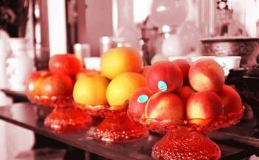
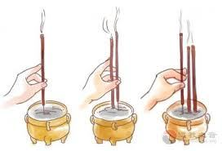
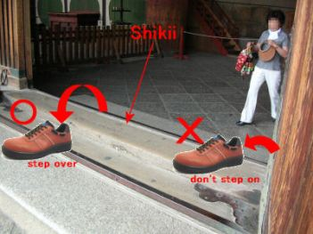
Taboos
◆ Offerings cannot be repeated for different worships | Fruit should be fresh and clean. Apples (peace), oranges (auspicious wishful), pineapples (fortune prosperous come) are very popular fruit
◆ Do not use right hand to insert incense | People think the right hand is not clean
◆ When people have physiological period, they cannot go to temple | folklore experts believe that, in fact, such a person is physically weak, if contact with a powerful energy (divine power), the body will be too much power and cannot endure it.
◆ Do not step on temple threshold | Because cross over the threshold is my home, so it is the declaration of sovereignty!
◆ Speak out what you want to pray to the God | Tell the God who you are, where you live and have what wishes.

Slide 10
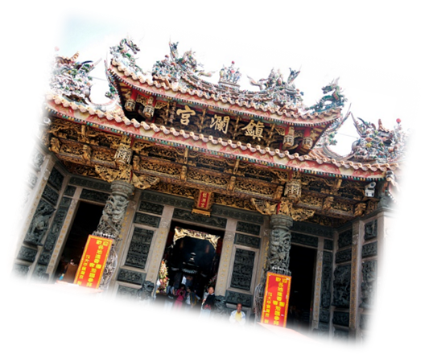
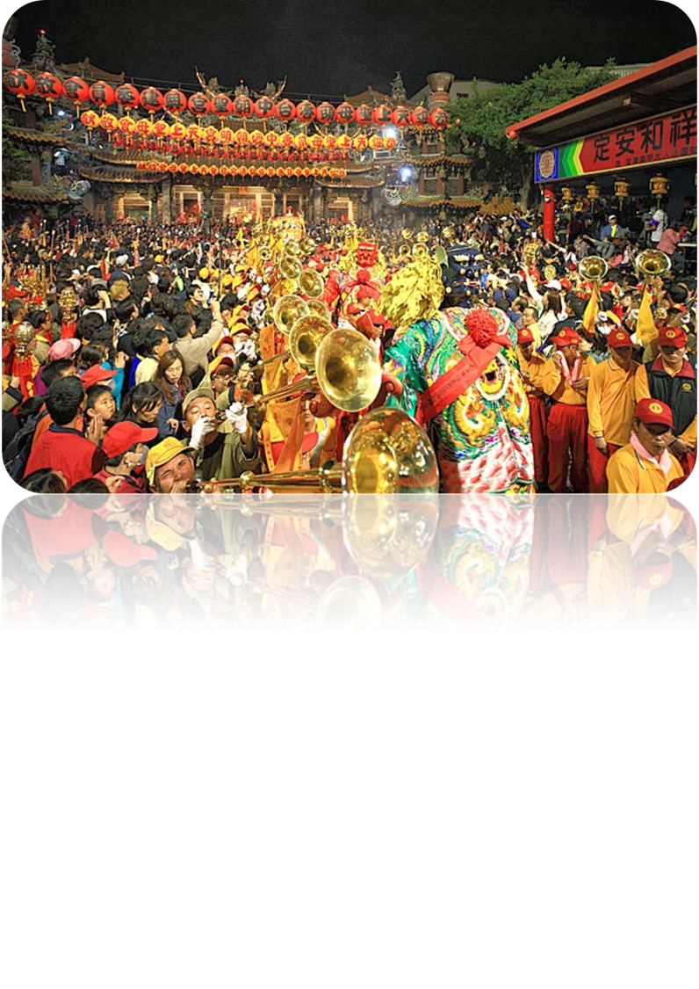
Most important religious festival in HsinKang
Dajia Mazu Pilgrimage
To celebrate Mazu’s birthday in mid April
Has visited Xingang for 30 years (to build the friendship )
Begin: Jenn Lenn Temple, Dajia, Taichung
End: Fengtian Temple, Xingang, Chiayi
Some 200,000 pilgrims walk up to 12 hours per day for nine days, carrying a statue of Mazu in a sedan chair. The journey covers 300 kilometers, much of it through mountainous and rugged terrain.
More than 100 temples and the west-coastal counties of Changhua, Yunlin and Chiayi are
visited on the route before it returns to Jenn Lann Temple.
Video:

Slide 11
9-days Pilgrimage route
Jenn Lenn Temple, Dajia, Taichung
Fengtian Temple, HsinKang, Chiayi

Slide 12
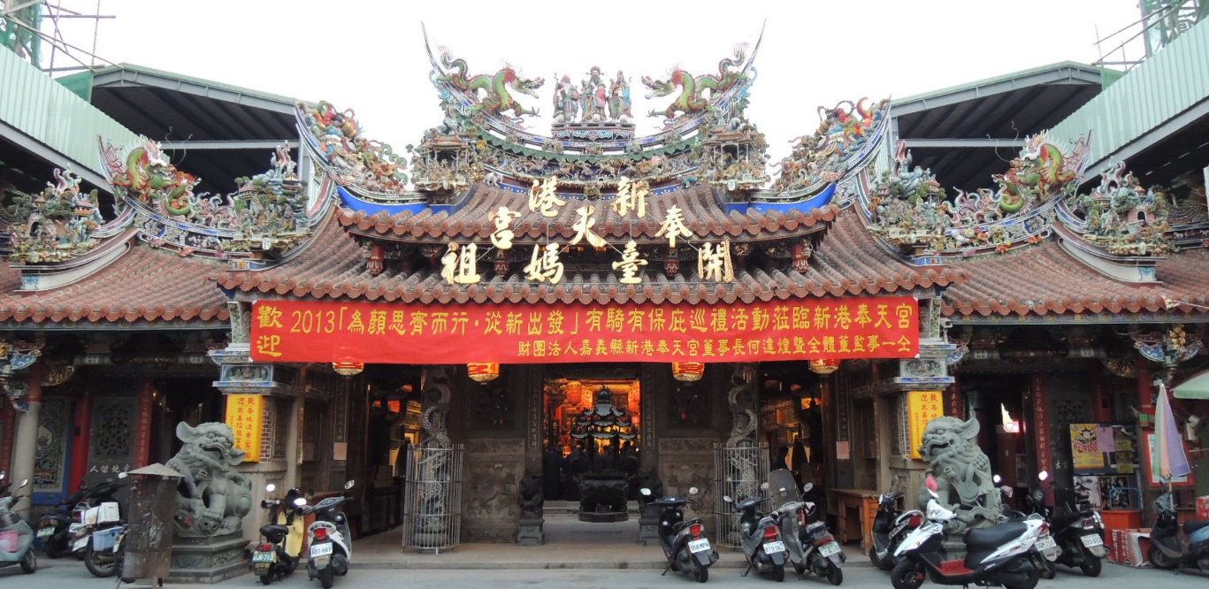
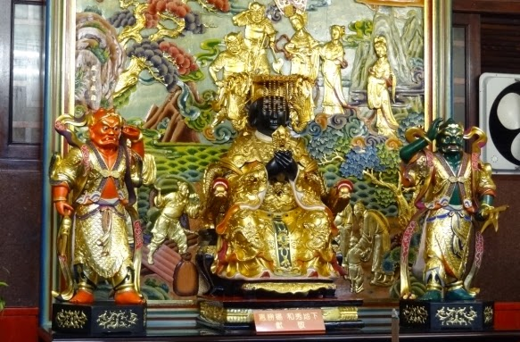
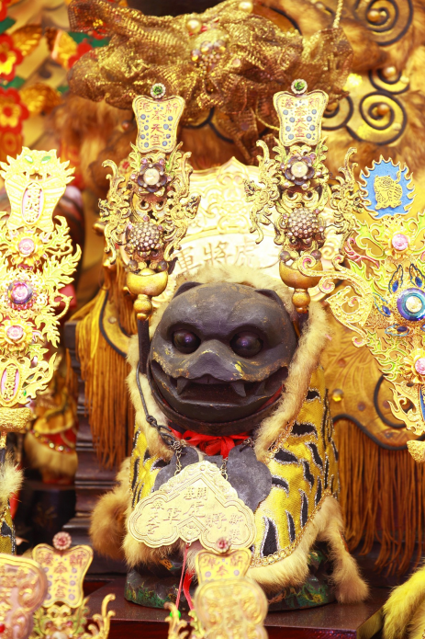
The stories of the Gods at FengTian Temple
Mazu
The sea Goddess
Thousand-Mile eye & Wind-Following Ear
Mazu’s guardian generals
Tiger God
Tiger General
Champion Tiger
Fengtian Temple

Slide 13
Mazu (Lin Mo-niang) Goddess of the sea
Why?
How&What?
Today, Matzu is worshipped as a goddess of the sea and the protector of fishermen and sailors.
When &Where?
Mazu’s traditional birthday was on the 23rd day of the 3rd month of the Chinese lunar calendar in the 13th century. It is celebrated widely in Taiwan, with the largest festivities^{[24]} around the 9-day, 300-kilometer annual "inspection tour“.
One day, she had a vision that her father and brother were caught in a storm at sea. Legend has it that Mazu magically went into a trance. While in this sleep-like state, her spirit went to save her family members. However, her mother saw her sleeping body and tried to wake her. When that happened, Mazu dropped her father, but luckily, she was still able to rescue her brother.
Mazu’s temples can be found in many fishing towns and on the coast of many Asian countries.

Slide 14
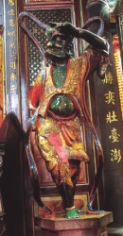
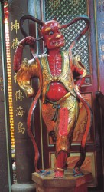
Qianliyan & Shunfeng’er – Mazu’s Guardian generals
The legend had it that the demons Qianliyan ("Thousand-Mile Eye") and Shunfeng’er ("Wind-Following Ear") both fell in love with her and she conceded that she would marry the one who defeated her in combat. Using her martial arts skills, however, she subdued them both and, after becoming friends, hired them as her guardian generals
Qianliyan ("Thousand-Mile Eye"), a farsighted person.
Shunfeng’er ("Wind-Following Ear"), a person who can hear voices a long way off

Slide 15
Tiger God FengTian Temple: The headquarters of the Tiger God in Taiwan
Why?
Local legend has it that the Jiaqing Emperor (1760 – 1820) dreamt of himself being rescued by the Tiger General, who fought off attacking demons. The Tiger General was therefore conferred the title of Champion Tiger and enshrines as a deity.
How&What?
Traditionally, Tiger God statues are placed under the altar, but because of its extraordinary feat, this one is enshrined on the altar and wears a golden wreath bestowed by the Jiaqing Emperor on its head. The statue is unique, both for the wreath and for having its own dedicated worship hall.
When &Where?
Today, there are hundreds of temples in Taiwan that have enshrined duplicates of the Tiger God statue; one even resides in far-off Turkey. Each year, on the birthday of the Tiger God, the 6th day of the sixth lunar month, the statue is seated in the main hall to allow believers to pay respects, and all the duplicate statues visit Fengtian Temple to pay homage to the original.

Slide 16
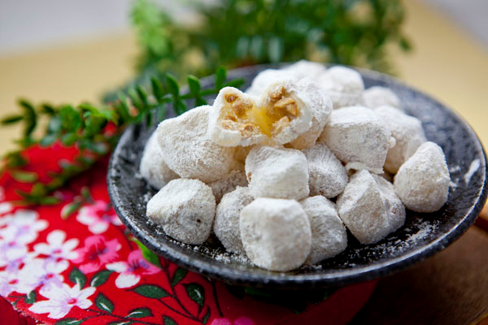
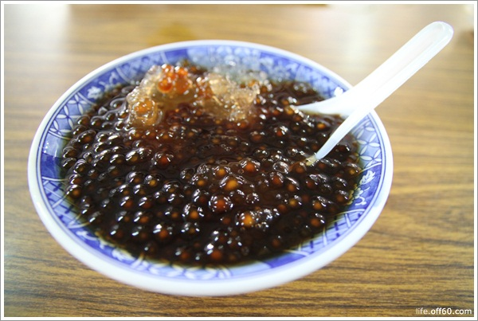
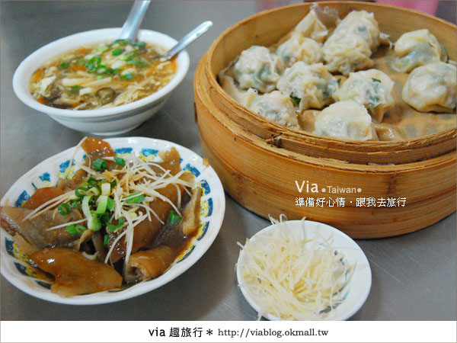
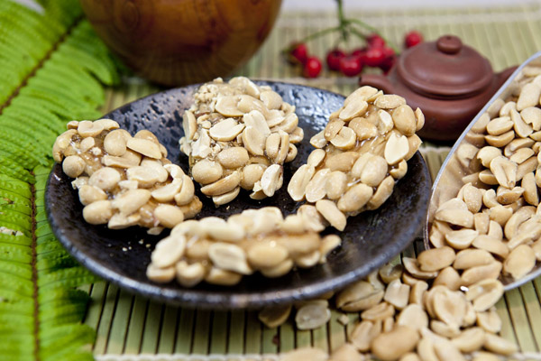
Delicacies around Fengtian Temple

Slide 17
People’s favorite snacks in HsinKang
duck thick soup
pearls with shaved ice
steamed dumplings

Slide 18
Try to describe the delicious food…
★Please describe them with the sentence patterns…
Questions:
A. How does ________________ look/smell/taste?
B. What does _______________ look/smell/ taste like?
Answers:
A. It looks/smells/tastes/ ____________________________________________________________________.
B. It looks/smells/tastes/ like ________________________________________________________________.
★ Please share your favorite food and the reasons…
My favorite food in Xingang is ________________ because it is _______________________________.

Slide 19
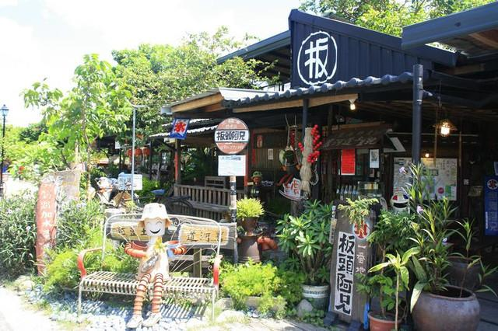
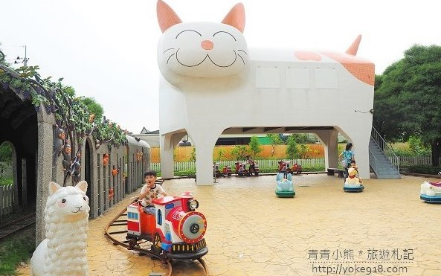
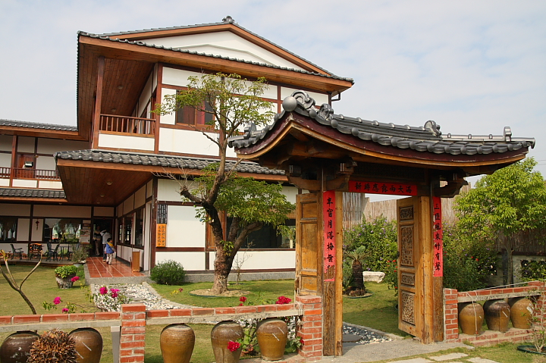
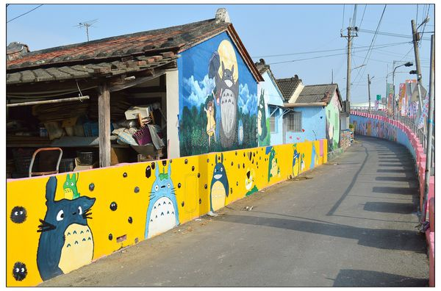
Tourist attractions around FengTian Temple

Slide 20
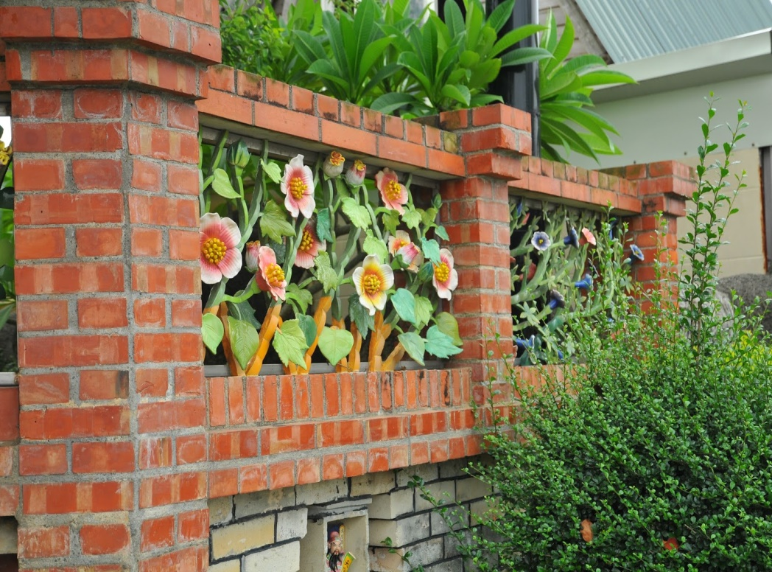
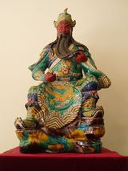
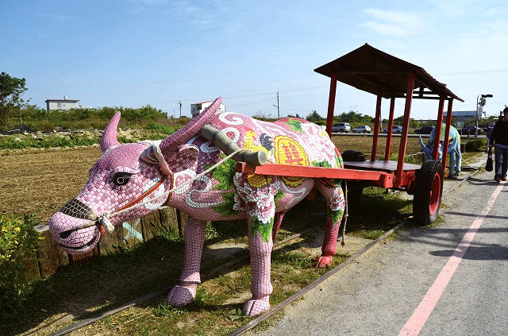
JiaoZhi Pottery Arts (Ceramic)
-What: Soft ceramic sintered in low temperature environments.
- How: In earlier times, JiaoZhi ceramic (pottery) was used for wall-decorations in numerous temples in Taiwan. Now some of the JiaoZhi ceramic trinkets have turned into household collections.
- Why: JiaoZhi figures are usually historic warriors, emperors, and animals in folklore, or figures depicting Chinese culture and history. The former serve as blessing symbols, as for the latter, they usually conduct moral lessons.

Slide 21
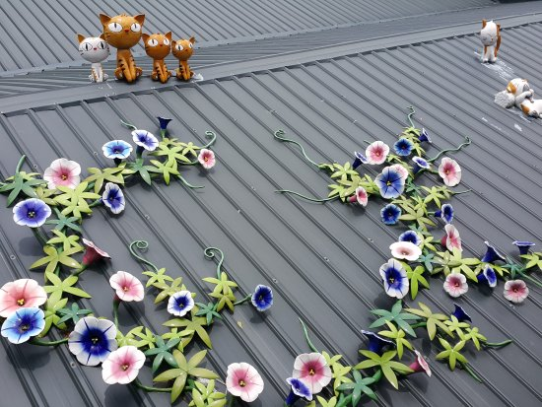
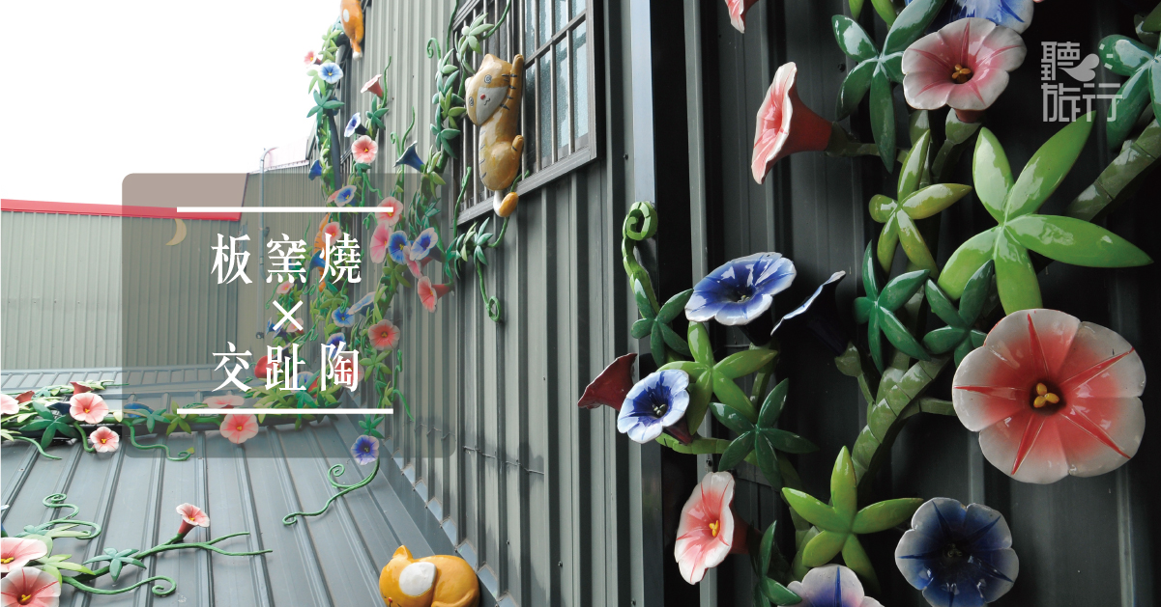
Bantaoyao Crafts Studio of JiaoZhi Pottery(Ceramic) & Chien-Nien
Who: In 2005, 陳忠正 謝秋緞, a couple in HsinKang township, uphold the enthusiasm of traditional arts and crafts founded the Bantaoyao Crafts Studio of Koji Pottery(Ceramic) & Chien-Nien(剪黏).
Why: Witnessing this outflow of talents and less and less young people are willing to learn, the couple decided to continue on inheriting this precious culture.

Slide 22
Try to share the tourist attractions in HsinKang
★Please share the details of the attractions with 6WH ways
A. What: name of the attraction
B. Who: people related to the attraction
C. Where: the direction/ place or location
D. When: the time to built the attraction
E. Why: the reasons to built the attraction
F. How: the ways / steps to built the attraction

Slide 23
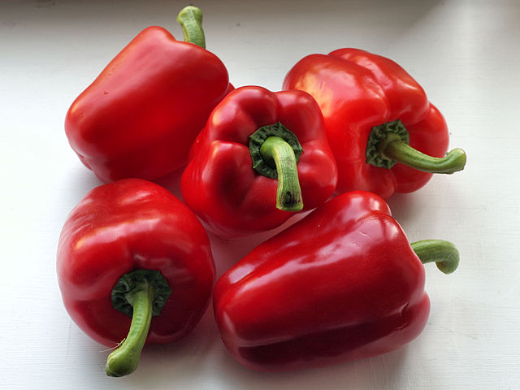
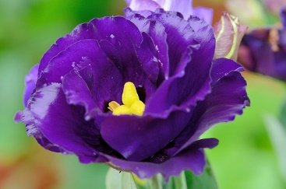
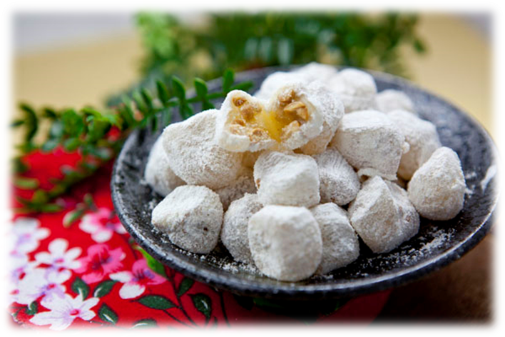
5 specialties (precious things) in HsinKang

Slide 24
Our specialties…
tomato
sweet pepper
Eustoma

Slide 25
Our specialties…
Jiaozhi pottery
HsinKang candy

Slide 26
Try to market the HsinKang 5 specialties with the sentence patterns and 6WH descriptions
A. If You visit Xingang, you must taste ________________ (food)
B. Becase _____________ looks/smells/tastes + adj….(food/flower)
C. It is grown here because it is __________(weather)___________ in Xingang. (food/flower)
D. It was made to ___________________(purpose)___________________________. ( place)
E. Please describe more details with 6WH descriptions…
What/who/when/where/why/how

Slide 27
Have a one-day trip in HsinKang
☆ Ask for directions:
How do I get to ___________________________________?
Do you know where _______________________ is?
☆ Tell the directions:
You can go to __________________ by bike / on foot.
Turn right/left on _____________ road , and you can see _________________ on your right / left / on the corner.
_______________ is in front/back of ______________?
_______________ is between A and B.

Slide 28
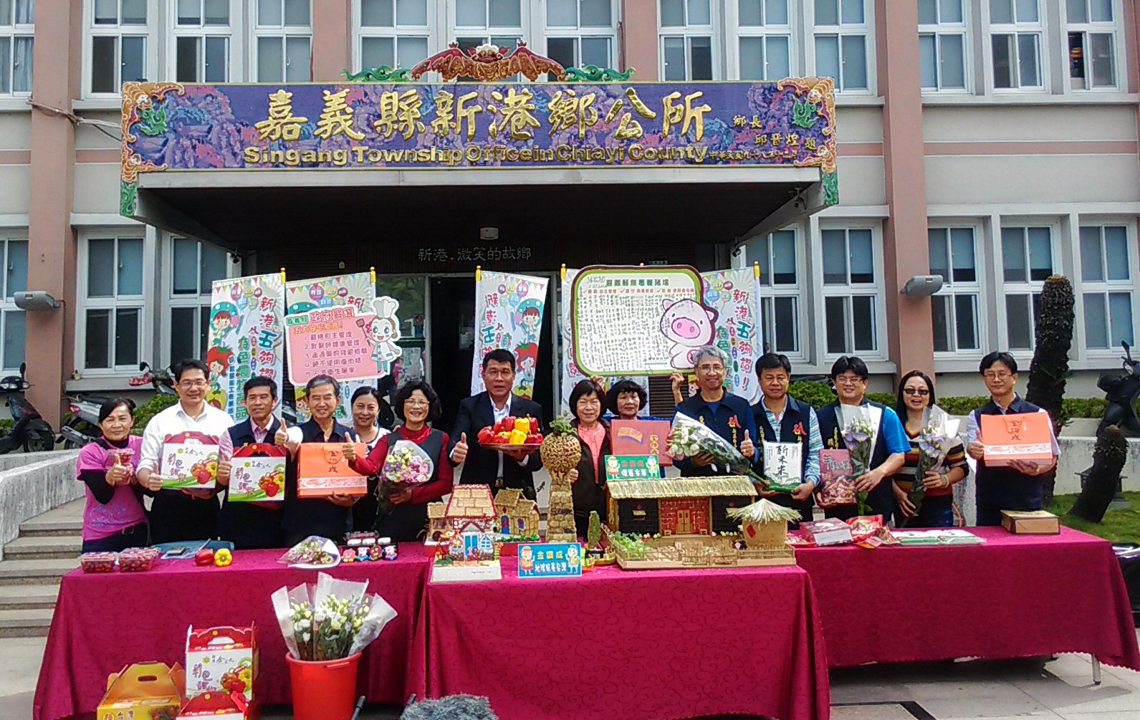
Hsingang is a good place for you to visit. We have wonderful tourist attractions and delicacies here. Welcome!!!

Slide 29
References
1.嘉義縣新港鄉『新港五夠讚』 http://tnews.cc/05/newscon1_1718.htm
2.嘉義縣新港鄉奉天宮 http://www.hsinkangmazu.org.tw/
3. 維基百科新港奉天宮 https://zh.m.wikipedia.org/wiki/新港奉天宮
4. 奉天宮歷史/平面圖 https://www.taiwangods.com/html/landscape_en/1_0011.aspx?i=72
5. 維基百科媽祖https://zh.wikipedia.org/wiki/%E5%AA%BD%E7%A5%96
6. 陣頭http://taiwan-itinerary.blogspot.tw/2013/08/temple-festivali-introduction.html
7. taboos https://helloworldfacts.wordpress.com/2018/02/27/5-taboos-when-visiting-the-temple-in-taiwan/
8. 新港景點 http://arthur5191.pixnet.net/blog/post/25552575-嘉義新港-初遊記
9. 大甲媽祖CNN報導http://travel.cnn.com/taiwan-mazu-religious-festival-pilgrimage-226351/
10. 南崙彩繪村 http://as660707.pixnet.net/blog/post/398915284-%E5%98%89%E7%BE%A9%E6%96%B0%E6%B8%AF%E6%99%AF%E9%BB%9E))%E5%8D%97%E5%B4%99%E5%BD%A9%E7%B9%AA%E6%9D%91_%E9%BE%8D%E8%B2%93%E5%BD%A9%E7%B9%AA%E5%A5%BD%E5%8F%AF%E6%84%9B
11. 板頭社區 http://itaiwantravel.com/place/attractions2/1439/2602
12. 交趾陶藝術https://www.tripadvisor.com.tw/LocationPhotoDirectLink-g13808494-d6553487-i257957451-Bantou_Jiao_Zhi_Pottery_Village-Xingang_Chiayi_County.html
13.交趾陶 http://blog.hearhere.com.tw/2016/11/kojipottery1.html
14.千里眼順風耳http://www.tcfsh.tc.edu.tw/contest/%A5x%A4%A4%A7%F2%B7˶%FD%AF%AA%BCq/c_02.htm
15. 關公交趾陶 http://www.wu-long.idv.tw/ko.htm

